Slide 1
CEDC COMMUNITY AZURE CLOUD LEARNING
Presenter Yi
2023.9
1

Slide 2
Evolution of Traditional Enterprise Data Platform
PHASE ONE
PHASE TWO
PHASE THREE
Data Warehouse
Data Lake
Data Lake in Cloud (Batch Job, Real Time Data Flow, ML etc.)

Slide 3



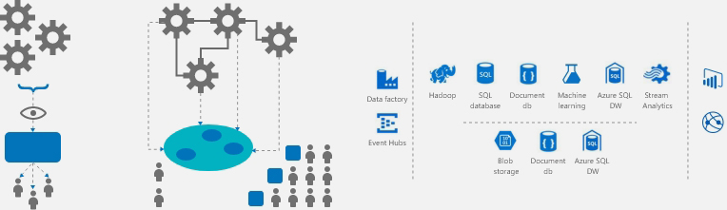
Evolution of Traditional Enterprise Data Platform
Data Warehouse
Data Lake
Lake in Cloud
3

Slide 4
Data Warehouse vs data lake vs lake in cloud
 | Data Warehouse | Data Lake | Lake in Cloud
Data source | Structure Data | Structure data, unstructured data and streaming log data | Structure data, unstructured data and streaming log data
Data mode | Write-schema | Read-schema | Read-schema
Data storage | Usually Stored in relation-database | Usually Stored in distribution system such as Hadoop | Stored in cloud production such as GCP bucket
Business Scope | Specific Business | Multiple Business | Multiple Business
Usage | Batch load, BI, DV | Batch load, BI, DV, ML, forecast analysis, data explore, data analysis | Batch load, BI, DV, ML, forecast analysis, data explore, data analysis
Data Quality | High | Low | Low
Infrastructure | On-Premise Server | On-Premise Cluster | Cluster On Cloud
4

Slide 5
AZURE CLOUD GO
WHY AZURE
WHEN AZURE
Get to Know Azure | Microsoft Azure
HOW AZURE
Cloud Computing Services | Microsoft Azure

Slide 6
AWS Vs azure vs gcp
AWS | Azure | GCP
SageMaker | Machine Learning | Vertex AI
Redshift | Synapse Analytics | BigQuery
EMR | Databricks | Dataproc
Glue | Data Factory | Cloud Data Fusion
Athena | Azure Synapse Analytics | BigQuery
Amazon EC2 | Azure Virtual Machines | Compute Engine
Amazon Elastic Block Store | Azure Blob Storage | Cloud Storage
AWS Lambda | Azure Functions | Cloud Functions
RDS | SQL Database | Cloud SQL
DynamoDB | Azure Cosmos DB | Cloud Firestore
Amazon EventBridge | Event Grid | Cloud Pub/Sub
Identity and Access Management | Azure Active Directory | Identity and Access Management
Key Management Service | Key Vault | Cloud KMS
Simple Storage Services | Blob storage | Cloud Storage
6

Slide 7





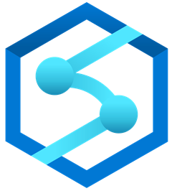



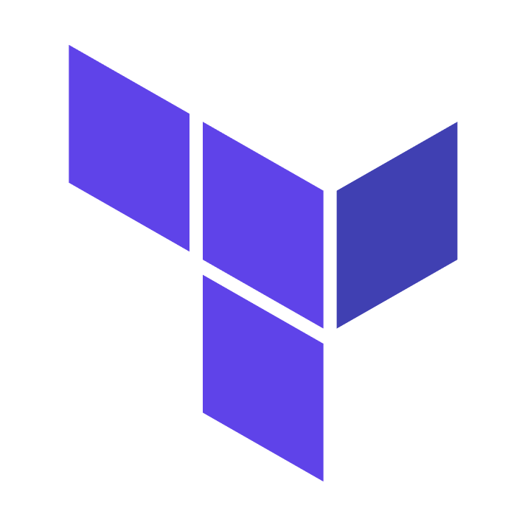



Data lake patterns on azure cloud
INGEST
STORE
TRANSFORM
SERVE
Data Factory
Event Hub
Data Lake Store G2
Data Factory
Azure ML
Power BI
Synapse Serverless SQL Pool
Data Bricks
BLOB
Data Bricks
Synapse Spark
DevOps
Azure DevOps
Terra Form
ARM
Security
Azure Active Directory
Key Vault
Azure Security Center
7

Slide 8
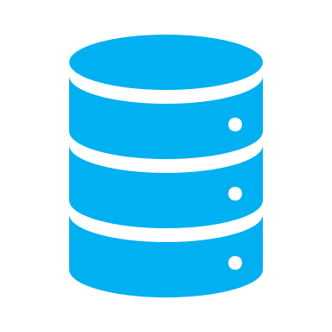

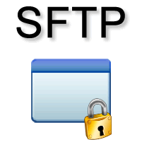
Data Lake Ingestion Patterns
Batch Ingestion
INGEST
STORE
TRANSFORM
SERVE
Database
Power BI
Data Factory
Folder Share
BLOB
Data Factory
Synapse Serverless SQL Pool
8

Slide 9
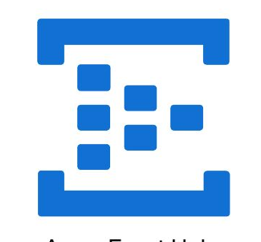
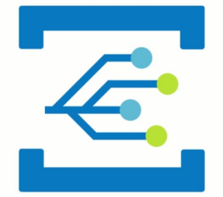

Data Lake Ingestion Patterns
Near-Realtime Ingestion
INGEST
STORE
TRANSFORM
SERVE
Database
Power BI
Event Hub
Data Bricks
BLOB
Data Factory
Synapse Serverless SQL Pool
Data Factory
Event Grid
9

Slide 10
Data Lake Patterns
Transformation
INGEST
STORE
TRANSFORM
SERVE
Power BI
BLOB
Data Factory
Synapse Serverless SQL Pool
10

Slide 11
Data Lake Patterns
Transformation
INGEST
STORE
TRANSFORM
SERVE
BLOB
Power BI
Synapse Serverless SQL Pool
11

Slide 12
Data Lake Patterns
Transformation
INGEST
STORE
TRANSFORM
SERVE
BLOB
Data Bricks
Power BI
12

Slide 13
Runtime Architecture
On premise
ETL
Key Vault
Data Factory
Data Bricks
Synapse SQL Pool
Power BI
Data Storage
CI/CD
CI/CD
BLOB
Data Lake Store G2
DevOps
One time
ARM
One time
Terra Form
Security
Key Vault
13

Slide 14
Development Architecture
On premise
ETL
Key Vault
Data Factory
Data Bricks
Synapse SQL Pool
Power BI
Data Storage
CI/CD
CI/CD
BLOB
Data Lake Store G2
DevOps
One time
ARM
One time
Terra Form
Security
Key Vault
14

Slide 15
Our Goals
Realized the popular data service feature on Azure cloud
Experienced the popular data service development on Azure cloud
Worked with the popular data service end to end with simple data
Achieved the CI/CD workflow with the popular data service pattern
15

Slide 16
Short Term action
Services | Sub services | Priority | Link | Owner | Member
Ingestion | Azure Event Hub/Azure Event Grid | P3 | Azure Event Hubs documentation | Microsoft Learn
Store | Data Lake Store G2 | P1 | Azure Data Lake Storage Gen2 Introduction - Azure Storage | Microsoft Learn
 | Azure Blob Storage | P1 | Azure Blob Storage documentation | Microsoft Learn
Transformation | Azure Data Factory | P1 | Azure Data Factory Documentation - Azure Data Factory | Microsoft Learn
 | Azure Databricks | P2 | Azure Databricks documentation | Microsoft Learn
 | Azure ML | P3 | Azure Machine Learning documentation | Microsoft Learn
 | Synapse | P1 | Azure Synapse Analytics - Azure Synapse Analytics | Microsoft Learn
16

Slide 17
Short Term action
Services | Sub services | Priority | Link | Owner | Member
Security | Azure Active Directory (Azure AD) | P1 | What is Azure Active Directory? - Microsoft Entra | Microsoft Learn
 | Azure Security Center | P3
 | Key vault | P1 | Azure Key Vault documentation | Microsoft Learn
Data Analysis | PowerBI | P1
DevOps | Terraform | P2 | Terraform on Azure documentation - Articles, samples, references, and resources - Terraform | Microsoft Learn
 | ARM | P2 | ARM template documentation | Azure Docs
 | Jenkins | P2 | Jenkins on Azure documentation - Jenkins | Microsoft Learn
17

Slide 18
Long term action
Action | Sub action | Priority | Owner | Member
Business Arc | Business requirement design | P1
 | Business technical design | P1
 | Data preparation | P1
Technical Solution Arc | Technical Pattern Design | P2
 | Technical principal Design | P2
 | POC | P2
DevOps Arc | DevOps Solution Design | P3
 | DevOps POC | P3
Technical Skills Training | Data engineer | P1
 | Data visualization engineer | P2
 | BA/Tester | P1
18

